Slide 1


Sybex CCENT 100-101
Chapter 2: Ethernet Networking and Data Encapsulation
Instructor & Todd Lammle

Slide 2

Chapter 2 Objectives
The CCENT Topics Covered in this chapter include:
Operation of IP Data Networks
Recognize the purpose and functions of various network devices such as Routers, Switches, Bridges and Hubs.
Select the components required to meet a given network specification.
Predict the data flow between two hosts across a network.
Identify the appropriate media, cables, ports, and connectors to connect Cisco network devices to other network devices and hosts in a LAN
LAN Switching Technologies
Determine the technology and media access control method for Ethernet networks
Identify basic switching concepts and the operation of Cisco switches.
Collision Domains
Broadcast Domains
2

Slide 3
Ethernet Networks in Review
Ethernet is a contention-based media access method that allows all hosts on a network to share the same link’s bandwidth.
Really pretty simple to implement and is so readily scalable.
Ethernet uses both Data Link and Physical layer specifications.

Slide 4
Figure 2.1: Legacy collision domain design
Figure 2.1 shows an old, legacy network that’s a single collision domain where only one host can transmit at a time.;
If two devices happen to transmit at the same time, it will cause a collision

Slide 5
Figure 2.2: A typical network you’d see today
Figure 2.2 shows a typical network design still used today and see if it’s any better.
Good start: More bandwidth is gained for users using switches because each port off a switch is a single collision domain;
Limitation: But switches do not break up broadcast domain

Slide 6
Figure 2.3: A router creates broadcast domain boundaries.
Figure 2.3 shows how a router would create a broadcast domain boundary.

Slide 7
Figure 2.4: CSMA/CD
When a host wants to transmit over the network, it first checks for the presence of a digital signal on the wire.
If all is clear and no other host is transmitting, the host will then proceed with its transmission.
If the host detects another signal on the wire, it sends out an extended jam signal that causes all nodes on the segment to stop sending data

Slide 8
Figure 2.4: CSMA/CD
The nodes respond to that jam signal by waiting a bit before attempting to transmit again. Backoff algorithms determine when the colliding stations can retransmit:
after mth collision, NIC chooses K at random from {0,1,2, …, 2^{m}-1}. NIC waits K·512 bit times, then retransmits the frame
apply longer backoff interval with more collisions

Slide 9
Figure 2.5: Half-duplex example
Figure 2.5 shows a network with four hosts connected to a hub.

Slide 10
Figure 2.6: Full-duplex example
Figure 2.6 shows four hosts connected to a switch, plus a hub, and definitely try not to use hubs if you can help it!

Slide 11
Figure 2.7: Ethernet addressing using MAC addresses
Figure 2.7 shows the 48-bit MAC addresses and how the bits are divided.

Slide 12
Figure 2.8: Typical Ethernet frame format
The function of Ethernet stations is to pass data frames between each other using a group of bits known as a MAC frame format. This provides error detection from a cyclic redundancy check (CRC). But remember—this is error detection, not error correction. An example of a typical Ethernet frame used today is shown in Figure 2.8.

Slide 13
Figure 2.9: Category 5 Enhanced UTP cable
There are three types of Ethernet cables:
Straight-through cable
Crossover cable
Rolled cable
The most common Ethernet cable used today is the category 5 Enhanced Unshielded Twisted Pair (UTP), shown in this figure

Slide 14
Figure 2.10: Straight-through Ethernet cable
Can be used to connect the following devices:
Host to switch or hub
Router to switch or hub

Slide 15
Figure 2.11: Crossover Ethernet cable
Notice that instead of connecting 1 to 1, 2 to 2, and so on, here we connect pins 1 to 3 and 2 to 6 on each side of the cable.
Can be used to connect Switch to switch, hub to hub, host to host, hub to switch, router directly to host and router to router

Slide 16
Figure 2.12: Typical uses for straight-through and cross-over Ethernet cables

Slide 17
Figure 2.13: UTP Gigabit crossover Ethernet cable
For a straight-through cable it’s still 1 to 1, 2 to 2, and so on up to pin 8. And in creating the gigabit crossover cable, you’d still cross 1 to 3 and 2 to 6, but you would add 4 to 7 and 5 to 8—pretty straightforward!

Slide 18
Figure 2.14: Rolled Ethernet cable
These are probably the easiest cables to make because you just cut the end off on one side of a straight-through cable, turn it over, and put it back on—with a new connector, of course!

Slide 19
Figure 2.15: Configuring your console emulation program
Notice that Bit Rate is set to 9600, Data Bits to 8, Parity to None, and Flow Control is set to None.

Slide 20
Figure 2.16: A Cisco 2960 console connections
Notice there are two console connections on this new switch—a typical original RJ45 connection, and the newer mini type-B USB console.
Remember that the new USB port supersedes the RJ45 port if you just happen to plug into both at the same time, and the USB port can have speeds up to 115,200 Kbps, which is awesome if you have to use Xmodem to update an IOS.

Slide 21
Figure 2.17: RJ45 UTP cable question #1
Now that you’ve seen the various RJ45 unshielded twisted-pair (UTP) cables, what type of cable is used between the switches in Figure 2.17?
A crossover cable is used here

Slide 22
Figure 2.18: RJ45 UTP cable question #2
What types of cables are used in the network shown in Figure 2.18?
Between switches, we use crossover cable;
Between router and console, we use rolled cable;
Router to switch or host to swtich, we use straight-through cable;

Slide 23
Figure 2.21: Data encapsulation
Figure 2.21 shows the PDUs and how they attach control information to each layer. This figure demonstrates how the upper-layer user data is converted for transmission on the network.

Slide 24
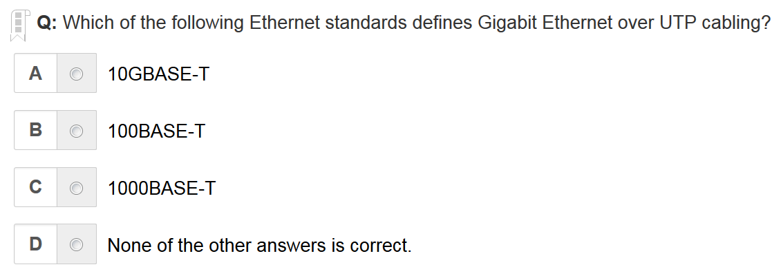
C is the correct answer

Slide 25
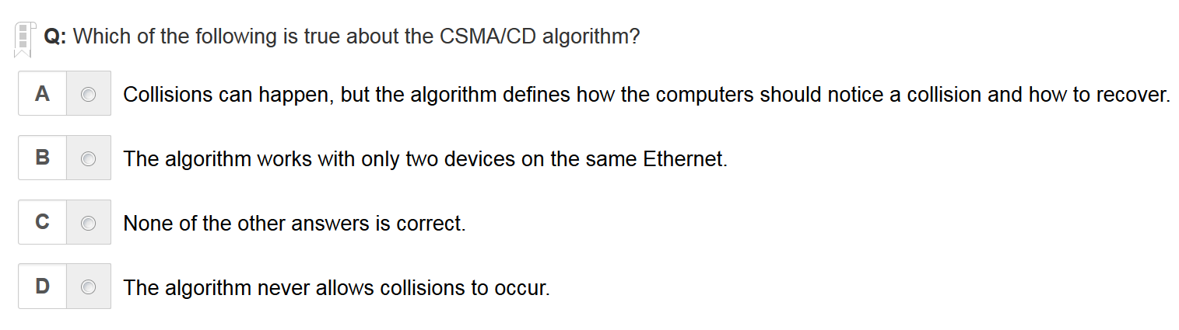
A is the correct answer

Slide 26
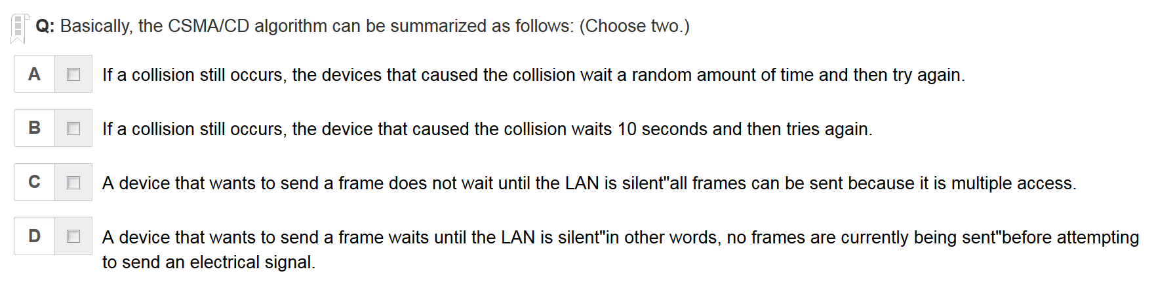
A D are the correct answers

Slide 27
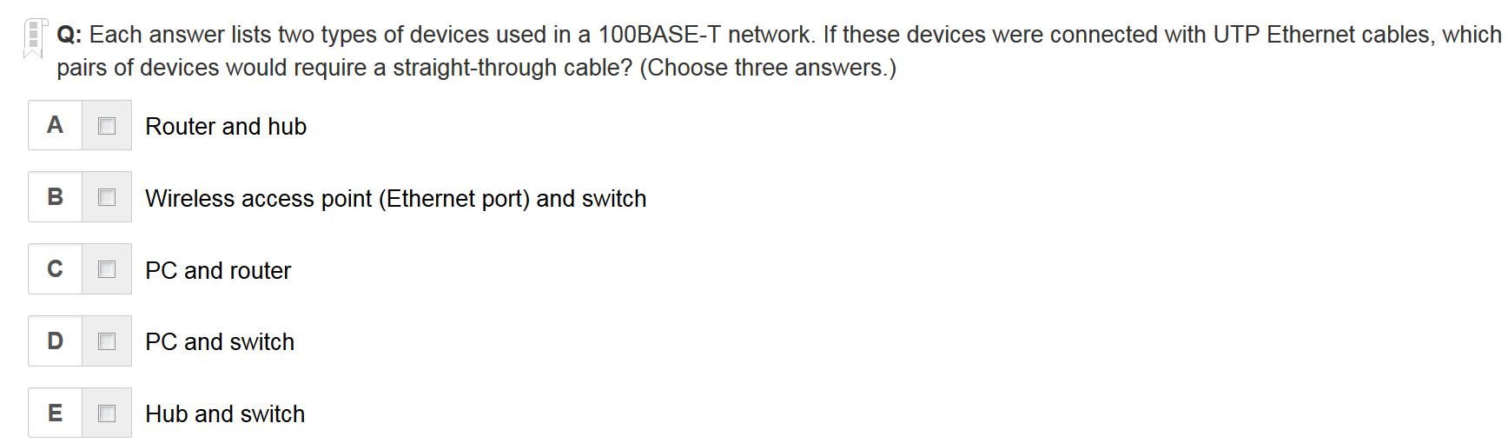
A, B, D are the correct answers

Slide 28
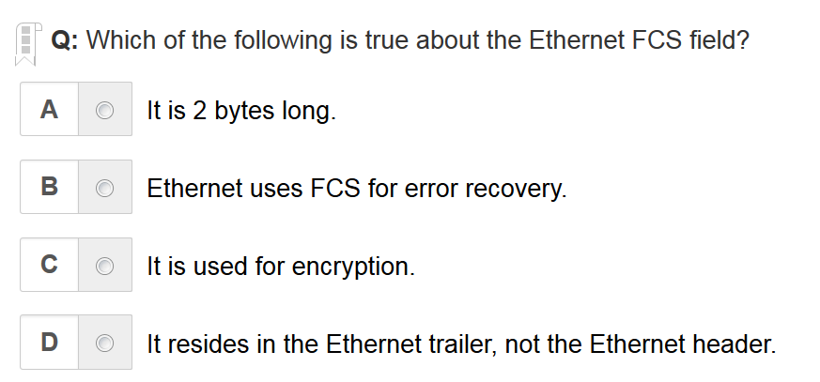
D is the correct answer
The 4-byte Ethernet FCS field, found in the Ethernet trailer, allows the receiving node to see what the sending node computed with a math formula that is a key part of the error-detection process. Note that Ethernet defines the process of detecting errors (error detection), but not error recovery.

Slide 29
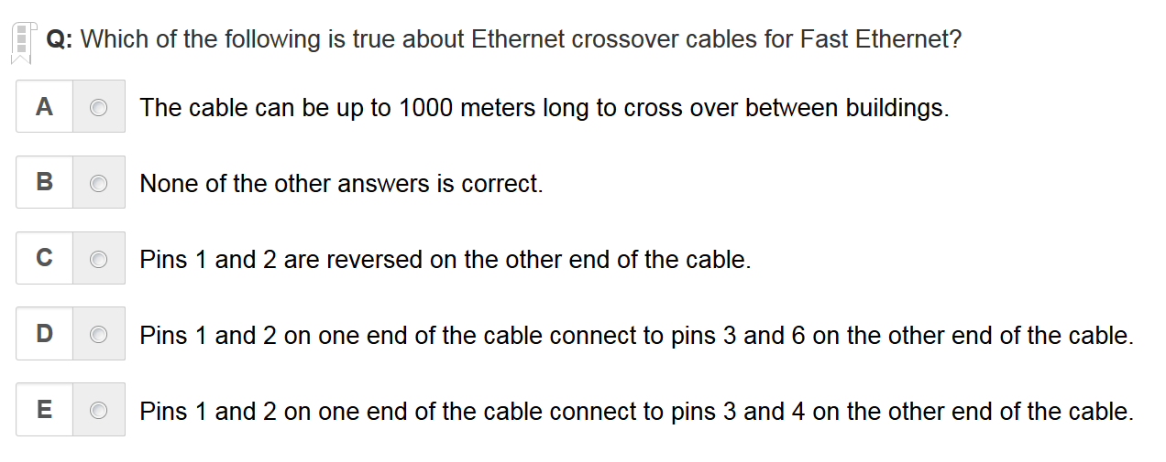
D is the correct answer

Slide 30
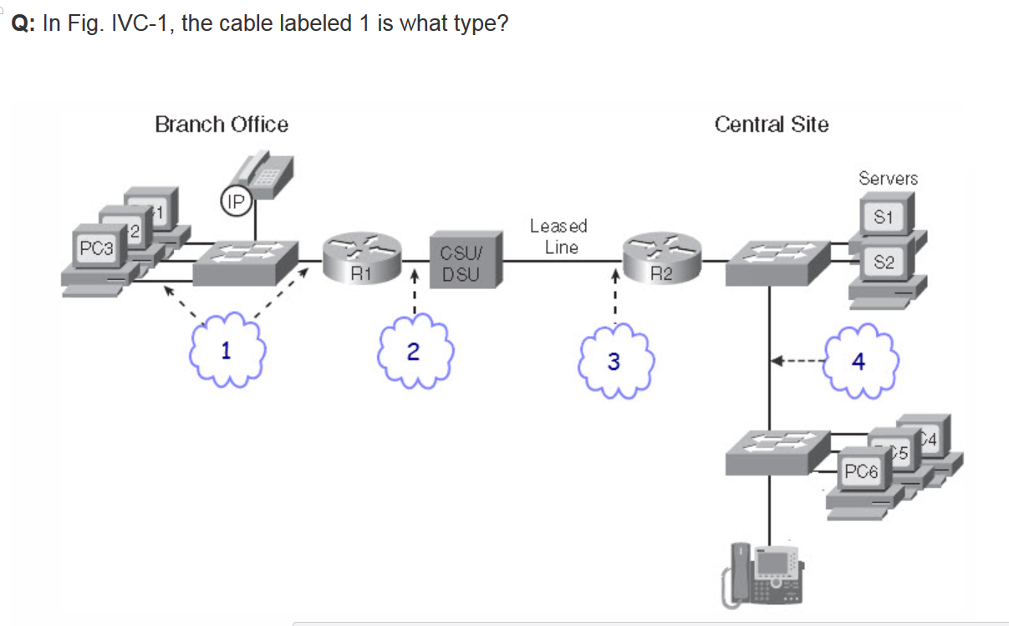
1 is UTP straight-through cable
4 is UTP crossover cable

Slide 31
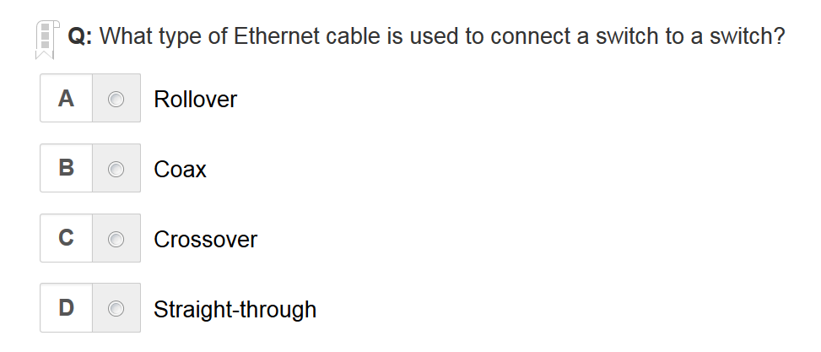
C is the correct answer

Slide 32
Written Labs and Review Questions
Read through the Exam Essentials section together in class
Open your books and go through all the written labs and the review questions.
Review the answers in class.
32

